Slide 1
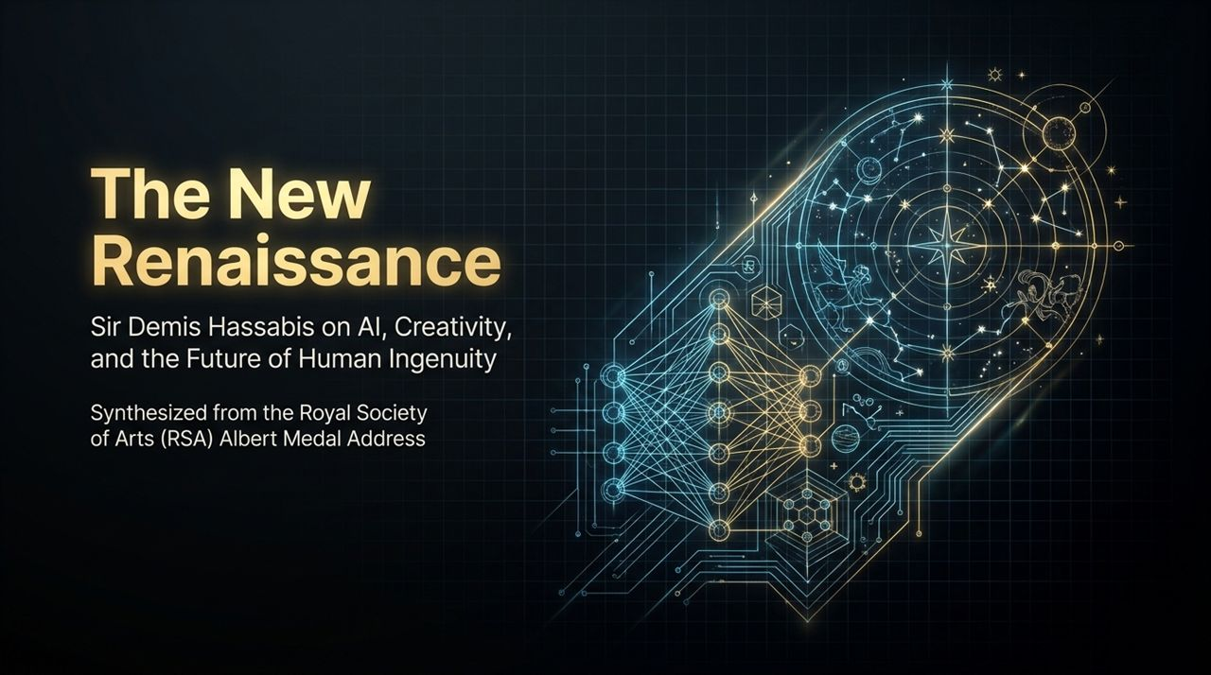
Notes:
Good morning/afternoon, everyone. Welcome to today’s presentation, titled "The New Renaissance: Sir Demis Hassabis on AI, Creativity, and the Future of Human Ingenuity."
This deck is synthesized directly from the Royal Society of Arts Albert Medal Address delivered by Sir Demis Hassabis—co-founder and CEO of Google DeepMind. The RSA has a long and storied history of honoring transformational ideas, from Alexander Graham Bell to Thomas Edison, and today we stand at a similar historical pivot point.
When we think about Artificial Intelligence today, the public debate is often dominated by binary extremes: either utopian promise or existential doom. But the perspective we are exploring today—pioneered by Demis Hassabis—offers a far richer framework. It views AI not merely as an automated efficiency tool, but as a meta-tool—a foundational capability that will spark a second Renaissance.
During the historical Renaissance, the wall between science and art did not exist. Leonardo da Vinci was simultaneously an artist, an engineer, an anatomist, and an inventor. However, over the last two centuries, specialization forced human knowledge into strict silos. Science went one way; the humanities and arts went another.
Today, as AI reaches human-level capabilities in logic, pattern recognition, and data synthesis, it forces us to ask fundamental questions: What is the true nature of human creativity? How do we combine scientific rigor with artistic intuition? And how can we steward this technology so that it leads to an era of global abundance rather than societal dislocation?
Over the next 15 slides, we will journey through Demis Hassabis’s personal trajectory—from chess prodigy and game developer to neuroscientist and AI pioneer. We will examine how AI acts as a prototyping engine for artists, an inverted model for education, and a "root-node solver" for humanity's greatest challenges in biology, energy, and climate.
Let’s step into the history of innovation and see why radical breakthroughs are almost always met with initial resistance.
https://www.youtube.com/watch?v=rDteJAuKiBI

Slide 2
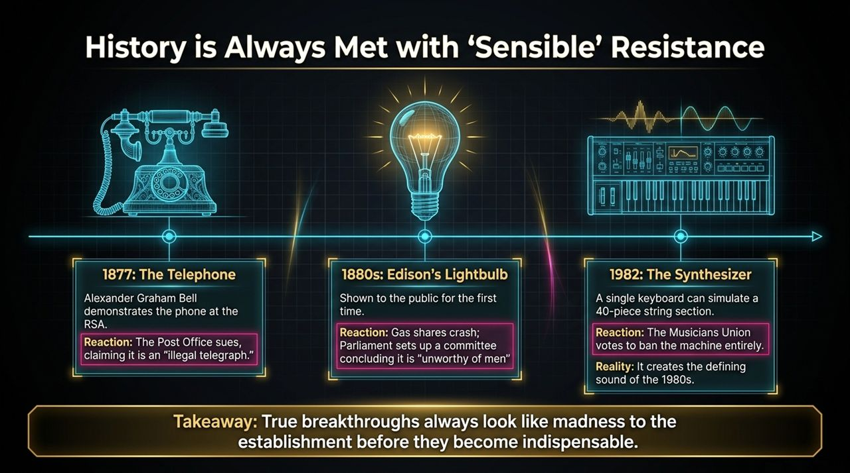
Notes:
Whenever humanity encounters a paradigm-shifting technology, the initial reaction from established institutions is almost never enthusiastic adoption—it is resistance. And remarkably, this resistance is usually framed as entirely "sensible" or legally justified at the time.
Let's examine three famous historical moments right here at the RSA:
First, in 1877, Alexander Graham Bell demonstrated the telephone. Instead of celebrating this miracle of voice communication, the Post Office sued Bell, arguing that the telephone was an "illegal telegraph" that infringed upon state monopolies.
Second, in the 1880s, Thomas Edison showed the public his incandescent lightbulb. The immediate economic reaction was panic: gas company shares crashed. Parliament convened a special committee to investigate electric light, and their official conclusion was that electric light was "unworthy of the attention of practical or scientific men".
Third, in 1982, the digital synthesizer emerged in the music industry. A single electronic keyboard could simulate a 40-piece string section. The Musicians Union was so terrified of job destruction that they voted to ban the synthesizer entirely from recordings and public performances. Yet, within years, the synthesizer didn't destroy music—it created the defining sound of the 1980s, gave rise to entirely new genres like electronic and pop music, and created more musical jobs than ever before.
The takeaway here is profound: True breakthroughs always look like madness to the establishment before they become indispensable.
Today, as we listen to critics warning about AI destroying creative industries or replacing human thought, we must recognize the pattern. The anxiety we feel today about Large Language Models, generative art, and automated coding is the exact same anxiety the Post Office felt in 1877, Parliament felt in 1880, and musicians felt in 1982.
Our task today is not to suppress the wave, but to understand its trajectory and harness it wisely.

Slide 3
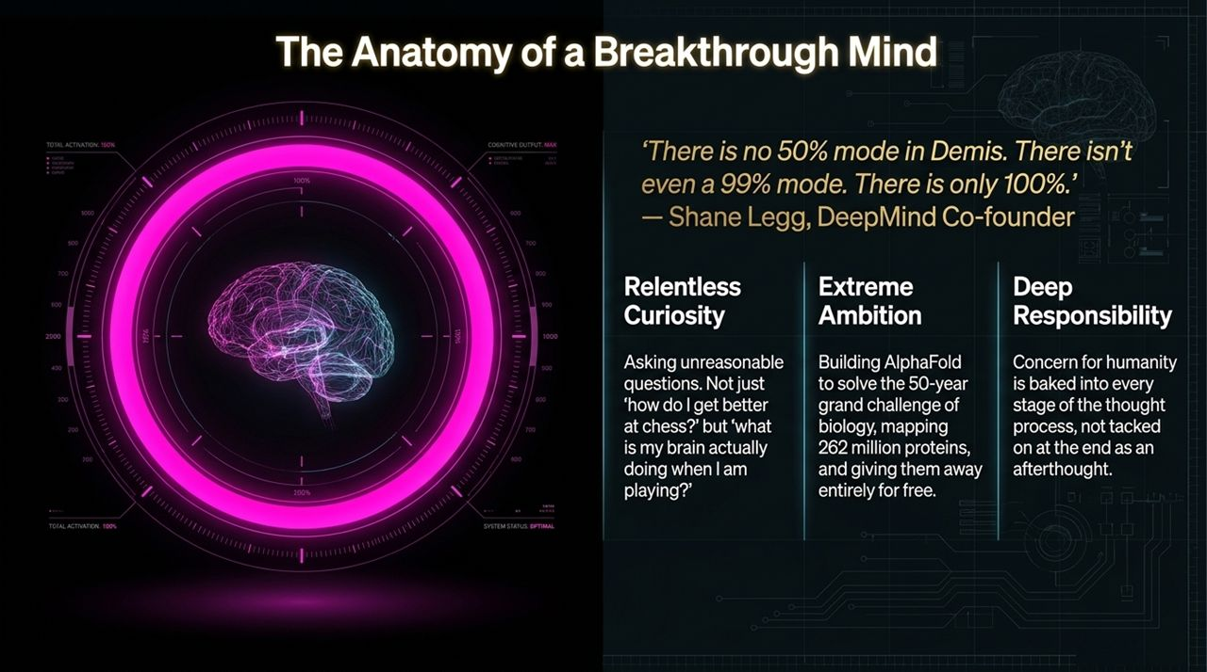
Notes:
To understand the philosophy of DeepMind and the future of AI, we have to look at the cognitive profile of its architect, Sir Demis Hassabis. Shane Legg, co-founder of DeepMind, once famously remarked: "There is no 50% mode in Demis. There isn't even a 99% mode. There is only 100%."
What does a "100% mind" look like in practice? It is built on three core pillars shown on this slide:
Relentless Curiosity: From a very young age as a child chess prodigy, Demis wasn't just content with winning games. He was asking meta-questions: Why does my mind choose this move? What is my brain actually doing when I am playing chess? Can a machine emulate this thought process? It’s this drive to ask "unreasonable questions" that breaks open new scientific fields.
Extreme Ambition: Many AI labs focus on incremental commercial applications—better ad targeting or faster search indexing. Demis set out to solve a 50-year-old grand challenge in biology: the protein folding problem. The result was AlphaFold, which mapped over 262 million protein structures—virtually every known protein to science—and made the database freely available to 2 million researchers worldwide.
Deep Responsibility: In Demis's view, concern for humanity cannot be tacked on at the end of a project as an afterthought or a PR exercise. Ethics, safety, and societal impact must be baked into every single stage of the research process from day one.
When you combine relentless curiosity, extreme ambition, and deep responsibility, you don't just build a successful tech company—you create an engine for global scientific progress. This mind-set is what drove DeepMind from a small startup in London to the premier AI research laboratory in the world.

Slide 4
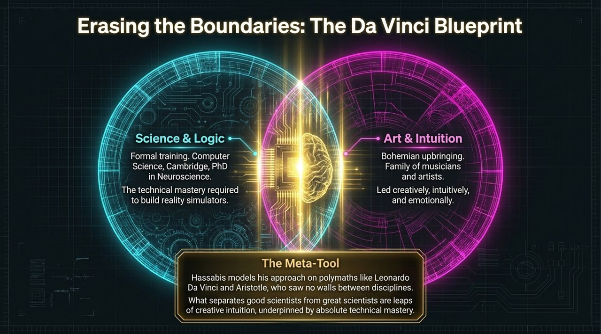
Notes:
If you look closely at history’s greatest innovators, they rarely fit neatly into a single box. On Slide 4, we see what we call "The Da Vinci Blueprint"—the deliberate erasure of boundaries between disciplines.
Demis Hassabis’s background is a perfect embodiment of this synthesis:
On the Science & Logic side, he received formal training in Computer Science at Cambridge and earned a PhD in Cognitive Neuroscience at University College London. This gave him the technical mastery to design complex algorithms and model brain mechanisms.
On the Art & Intuition side, he grew up in a bohemian, artistic household surrounded by musicians and creative thinkers. This instilled an intuitive, emotional, and aesthetic understanding of the world.
Demis explicitly models his approach on polymaths like Leonardo da Vinci and Aristotle. During the Renaissance, da Vinci didn't view his anatomical drawings as separate from his paintings; his understanding of human muscles directly informed the expression on the Mona Lisa.
In modern scientific research, we often fall into the trap of believing that pure logic and compute power are enough. But compute power only gives you brute-force search. What separates good scientists from true pioneers are leaps of creative intuition—the ability to connect two seemingly unrelated fields, underpinned by absolute technical mastery.
When we apply AI to science or the arts, AI acts as a meta-tool. It doesn't replace the human intuition; it magnifies it. It allows a scientist or artist to test intuitive hypotheses in seconds rather than decades. To build the future of AI, we must re-learn how to think like Renaissance polymaths, tearing down the artificial walls between STEM and the humanities.

Slide 5
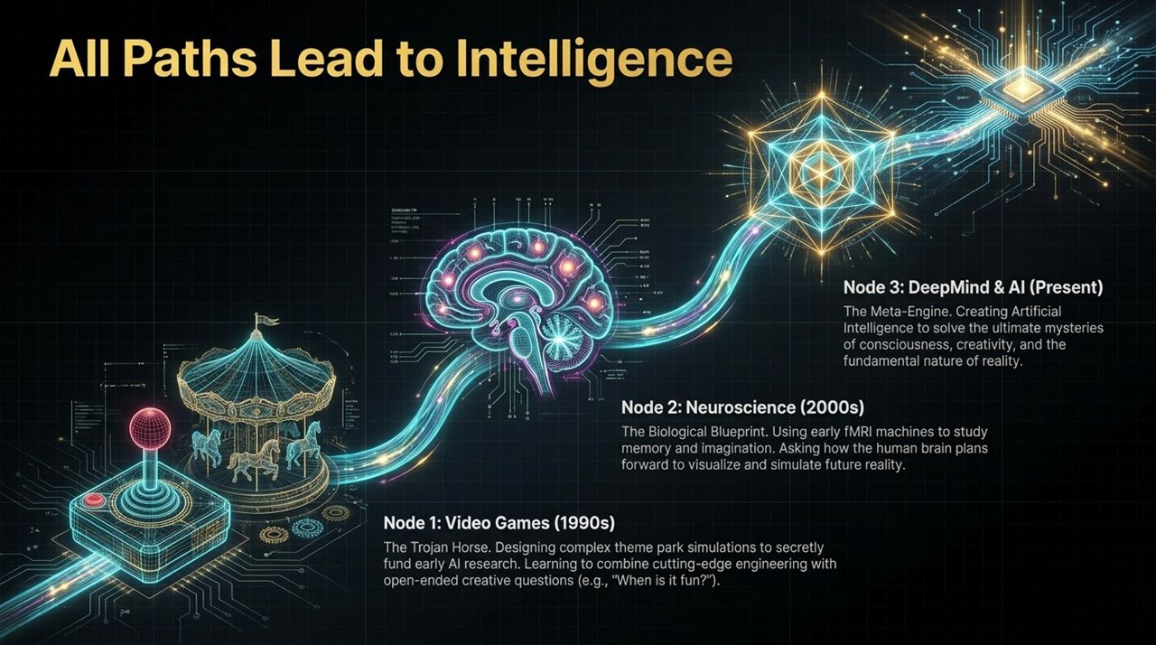
Notes:
How do you actually go about building Artificial General Intelligence? Looking back at Demis Hassabis's career, we can trace a fascinating 30-year arc across three distinct nodes, where every single step was a deliberate building block toward AGI.
Node 1: Video Games in the 1990s — The Trojan Horse
In his late teens and early twenties, Demis was a lead designer on legendary simulation games like Theme Park and Republic: The Revolution. On the surface, these were commercial entertainment products. But in reality, video games served as a "Trojan Horse." They provided a funded, low-risk sandbox to build complex world simulations and early AI algorithms. In games, you have to solve hard engineering problems, but you also have to answer open-ended subjective questions like: "When is a simulation actually fun?" or "How do non-player characters act realistically?"
Node 2: Neuroscience in the 2000s — The Biological Blueprint
Realizing that software engineering alone was insufficient to understand general intelligence, Demis stepped away from the gaming industry to pursue a PhD in Cognitive Neuroscience. Using early fMRI machines, he published landmark studies on human memory, imagination, and the hippocampus. He discovered that the same neural mechanisms the human brain uses to recall past memories are used to reconstruct future scenarios and simulate reality. This insight—that imagination is forward-planning based on memory—became a foundational architecture for AI.
Node 3: DeepMind & AI in the Present — The Meta-Engine
In 2010, these two streams merged to create DeepMind. By combining reinforcement learning (from games) with deep neural networks (inspired by neuroscience), DeepMind created systems like AlphaGo, AlphaZero, and AlphaFold.
Notice the progression: Video games taught him how to build virtual environments; neuroscience revealed how the human brain navigates those environments; and AI synthesized both into a meta-engine capable of solving fundamental scientific problems. All paths led to intelligence.

Slide 6
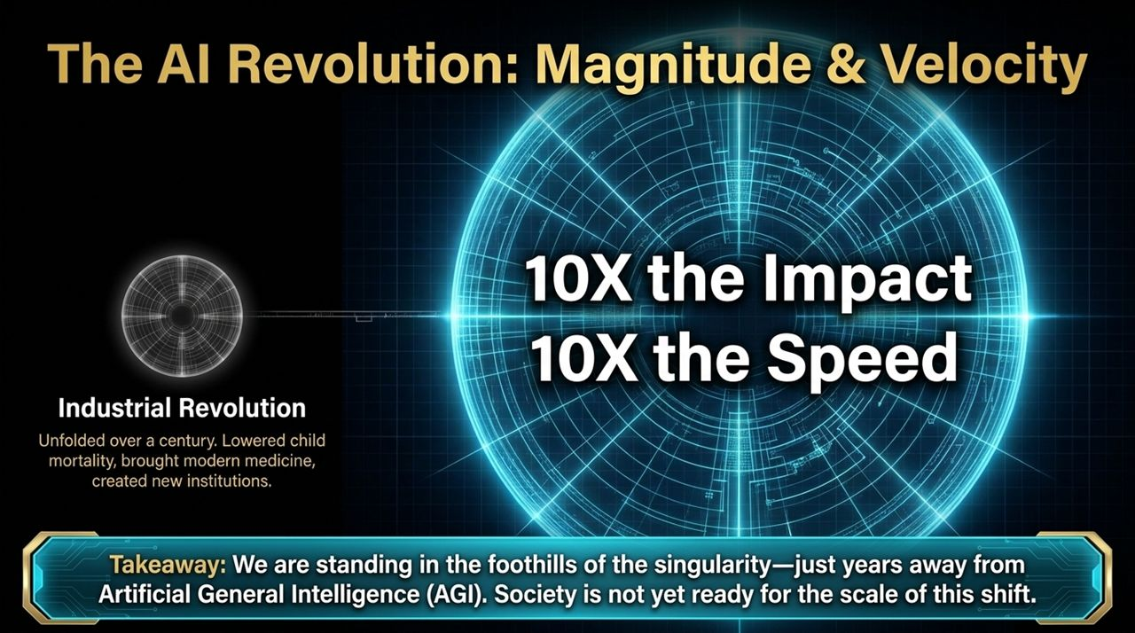
Notes:
To appreciate where we are in history, we need to compare the current AI revolution with the greatest technological shift of the modern era: the Industrial Revolution.
The Industrial Revolution replaced human physical muscle with steam, steel, and mechanical power. It completely reshaped human civilization. It lowered infant mortality, created modern medicine, built cities, and established our modern educational and legal institutions. But notice two critical characteristics of the Industrial Revolution:
It unfolded over more than a century.
It primarily impacted physical labor.
Now, look at the AI Revolution. It operates on a scale of 10X the Impact at 10X the Speed.
Why 10X the impact? Because AI is not automating physical muscle—it is augmenting human cognition, intelligence, and scientific discovery. Intelligence is the foundational multiplier for every other field of human endeavor—medicine, physics, energy, transport, and art.
Why 10X the speed? Because digital technologies scale exponentially, not linearly. Changes that used to take three generations are now happening within 3 to 5 years.
As Demis points out, we are currently standing in the foothills of the singularity—just years away from achieving Artificial General Intelligence (AGI). The fundamental challenge is that human institutions, laws, and social structures evolve linearly, while AI evolves exponentially. Society is not yet fully prepared for the sheer velocity and magnitude of this transition.

Slide 7
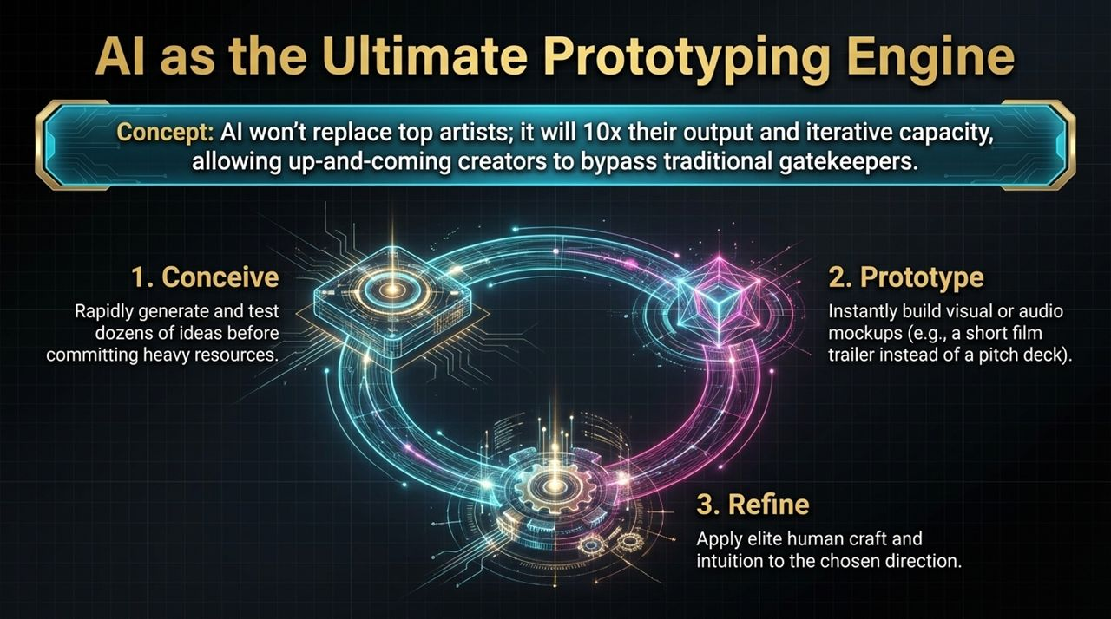
Notes:
Let’s address one of the most common fears surrounding AI: Will AI replace human artists, writers, and creators?
The vision presented on Slide 7 is reassuring and empowering. AI will not replace top creators; rather, it will act as the ultimate prototyping engine, increasing their iterative capacity by 10x and lowering the barrier to entry for up-and-coming talent.
Consider the traditional workflow of creative projects—whether making a feature film, designing architecture, or composing music. Traditionally, the bottleneck has always been the transition from idea to prototype. Pitching a movie required writing long scripts and spending millions on pre-visualization or pilot scenes.
With AI tools, the workflow is compressed into three seamless steps:
Conceive: Creators can rapidly generate, explore, and test dozens of creative concepts in minutes without committing massive financial resources.
Prototype: Instead of bringing a static pitch deck to a studio executive, an independent director can instantly generate a fully rendered visual and audio video trailer showcasing their artistic vision.
Refine: Once the best direction is selected, elite human craft, taste, and emotional intuition are applied to polish the final work.
This democratizes creation. Historically, massive studios acted as gatekeepers because they controlled the capital required to prototype ideas. AI strips away those gatekeepers, allowing a solo creator with a great story to produce works that previously required a $100 million budget.

Slide 8
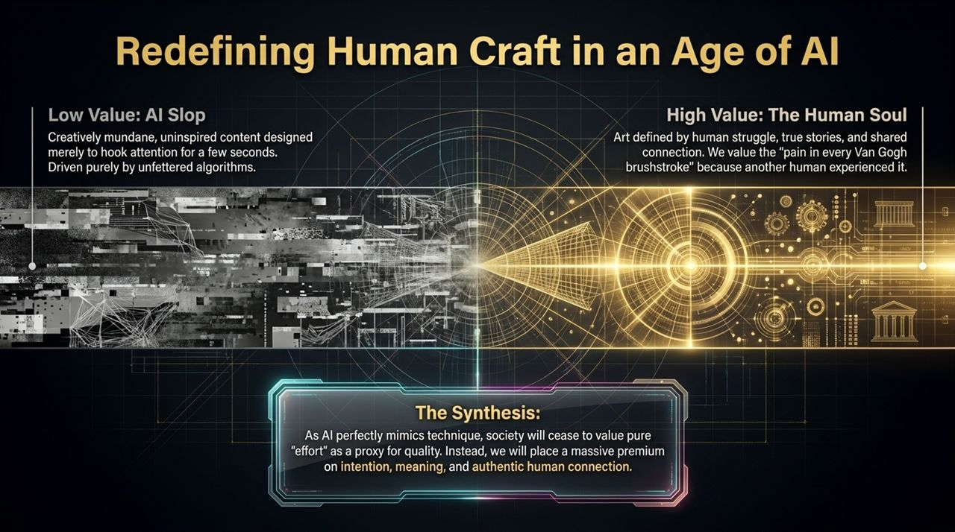
Notes:
As AI becomes hyper-capable at generating text, visuals, and audio, we enter a period where technical execution is no longer scarce. This forces a fundamental shift in how society values human effort and art.
On this slide, we contrast two ends of the digital spectrum:
On the low end, we have what is now termed "AI Slop." This is low-effort, algorithmically generated content designed solely to hijack attention algorithms for ad clicks. It lacks depth, meaning, or intentionality. As the web gets flooded with this noise, viewers quickly develop fatigue.
On the high end, we have The Human Soul. Why do we travel to Paris to stand in front of Van Gogh's Starry Night when we can buy a 4K digital print for $10? We don't stand there to admire perfect paint application; we stand there because we feel connected to Van Gogh's personal struggle, his isolation, his unique perception of light, and his humanity. We value the "pain in every brushstroke" because another human living being experienced it.
The Synthesis: As AI perfectly mimics technical proficiency, society will stop using "sheer effort or time spent" as a proxy for artistic quality. When an AI can render a photorealistic painting in 2 seconds, technical execution becomes commodity.
What becomes ultra-scarce and valuable? Intention, meaning, narrative, and authentic human connection. AI will handle the technical execution, freeing human creators to focus entirely on vision, depth, and emotional resonance.

Slide 9
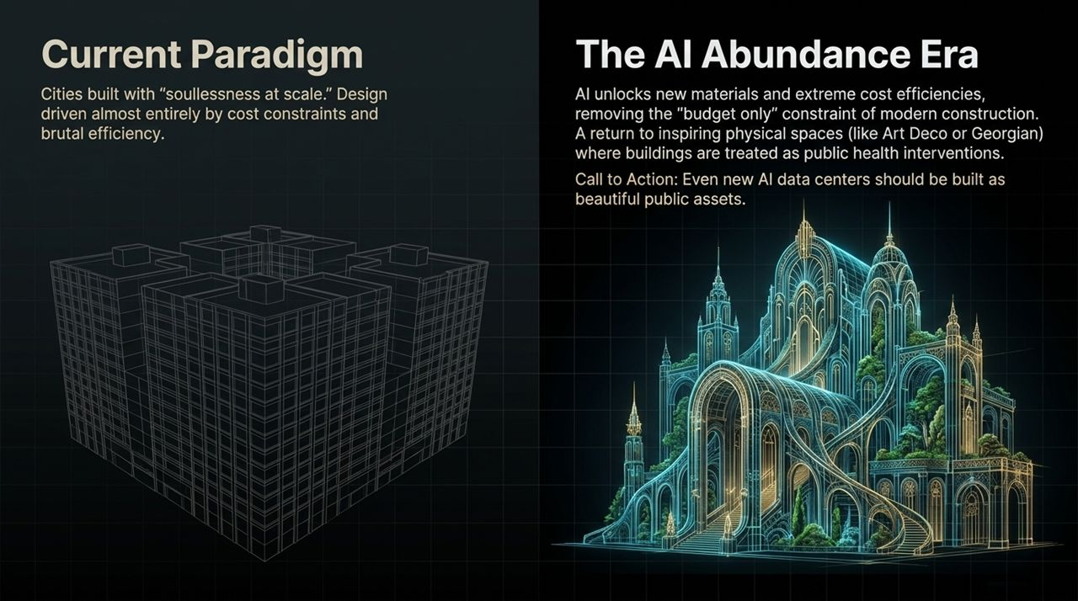
Notes:
The impact of AI isn't confined to digital screens—it will radically reshape our physical, built environment.
If you look at modern urban architecture over the past 70 years, much of it suffers from what Demis calls "soullessness at scale." Blocky, utilitarian concrete structures dominate our skylines. Why? Not because architects lacked imagination, but because of harsh economic constraints. Custom stonework, intricate curves, complex structural geometry, and artisanal materials are prohibitively expensive. Modern building design was forced into extreme cost optimization.
In the AI Abundance Era, this paradigm gets inverted:
AI materials science will allow us to discover novel, lightweight, ultra-durable, and inexpensive building materials.
AI design software can optimize intricate structural forms—like Gothic arches or Art Deco ornamentation—ensuring structural integrity while minimizing material waste.
This removes the "budget-only" constraint on physical architecture. We can return to building public spaces that uplift the human spirit—treating civic architecture not just as functional shelters, but as public health interventions that foster community well-being.
Demis even issues a direct call to action to the tech industry: As tech companies spend hundreds of billions building massive AI data centers across the world, we must refrain from building giant grey concrete boxes. Even data centers should be designed as beautiful, inspiring public assets that harmonize with nature and civic life.

Slide 10
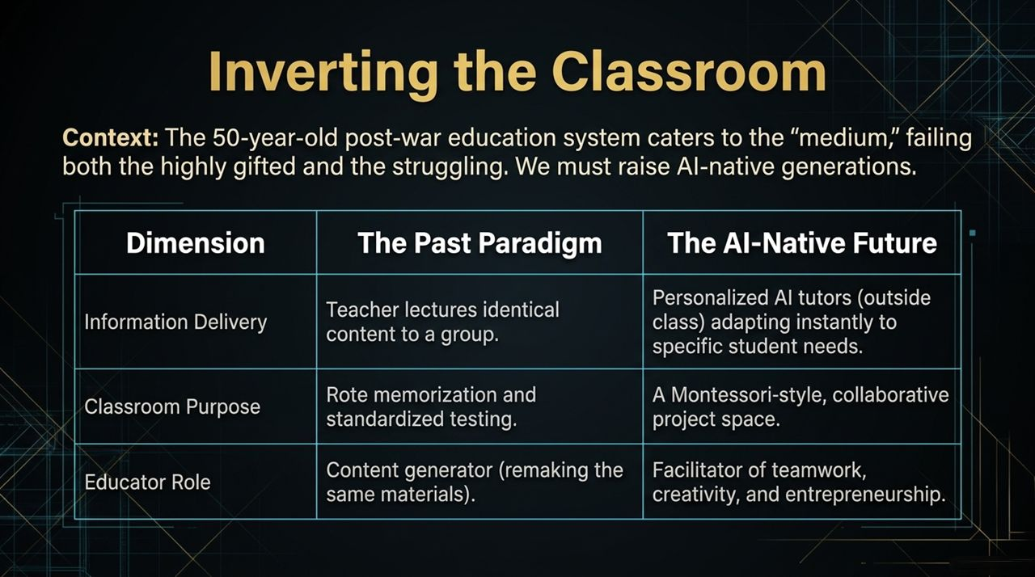
Notes:
Now let's examine education. Our current educational infrastructure was designed over 150 years ago during the Industrial Revolution. It operates like an assembly line: kids are grouped by manufacturing date (their age), seated in rows, and taught identical standardized material at an identical pace.
This model naturally caters to the "average" student—meaning it frequently fails both ends of the spectrum. Gifted students get bored, while struggling students fall behind and give up.
To raise an AI-native generation, we must invert the classroom:
Information Delivery: In the past paradigm, teachers stood at the chalkboard lecturing identical content to 30 kids. In the AI-native future, every single child will have a personalized 1-on-1 AI tutor. The AI tutor adapts in real-time to the child's learning pace, tone, interests, and gaps in knowledge. If a child learns better through visual analogies or gamified logic, the AI tailors the lesson instantly.
Classroom Purpose: If information delivery happens personalized outside class via AI, what is the physical classroom for? It transforms into a Montessori-style collaborative studio. School becomes a venue for hands-on team projects, social interaction, debates, and creative problem-solving.
Educator Role: Teachers are freed from the burnout of repetitive grading and lecturing. They step into their true calling as mentors, facilitators of teamwork, emotional coaches, and guides for student entrepreneurship.
By pairing AI-driven personalized instruction with human-centric social learning, we can unlock the full latent potential of every student.

Slide 11
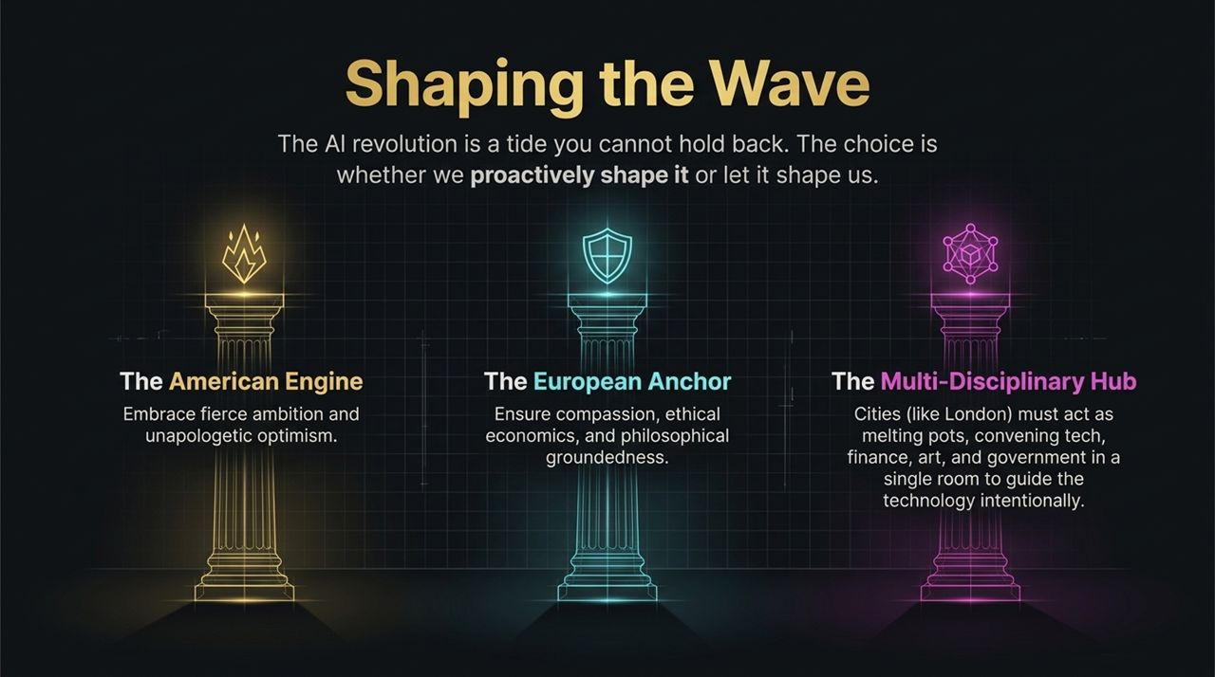
Notes:
The AI revolution is a force of nature—it is a tide that no government, policy, or institution can hold back. The real choice before us is not whether AI will happen, but how we shape it. Will we proactively guide this technology toward human flourishing, or will we let it passively shape us?
To successfully navigate this wave, we need to combine three distinct global strengths, as outlined on Slide 11:
The American Engine: We need the fierce ambition, venture capital dynamism, scale, and unapologetic technological optimism that defines Silicon Valley. Without this engine, innovation stalls.
The European Anchor: We need Europe’s deep commitment to human rights, ethical governance, economic fairness, and philosophical grounding. The anchor ensures the ship doesn't capsize into unbridled exploitation or unsafe deployment.
The Multi-Disciplinary Hub: Cities like London are uniquely positioned to serve as global convening points. London brings together world-class AI research, global financial markets, deep artistic traditions, and international policy-making within a single square mile.
We cannot leave AI development solely in the hands of technologists isolated in silicon valleys. We must convene technologists, ethicists, artists, trade unions, and world leaders in the same room to intentionally chart the course forward.

Slide 12
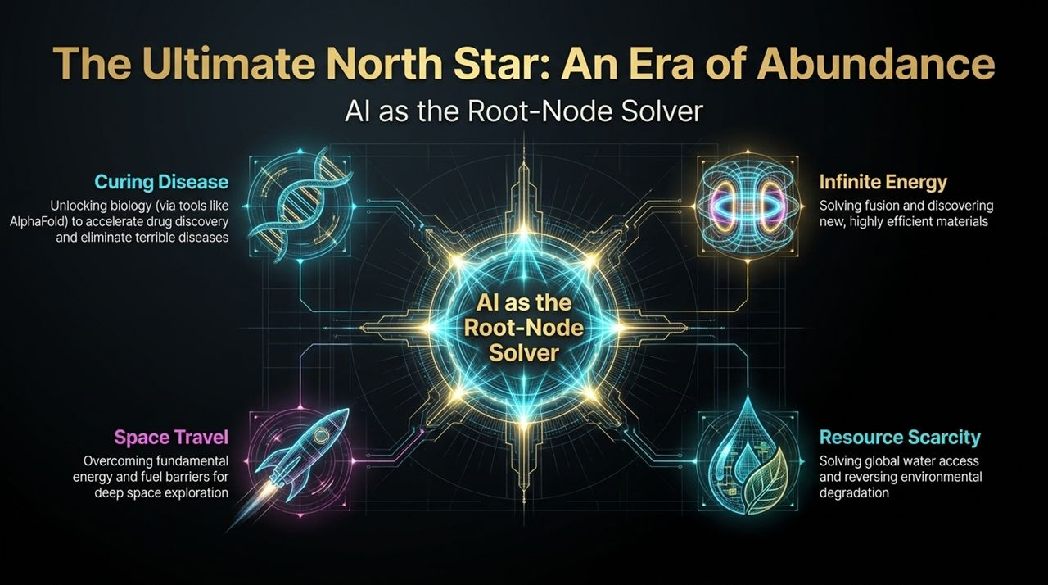
Notes:
What is the ultimate purpose of building Artificial General Intelligence? Why dedicate so much talent and capital to this pursuit?
Demis Hassabis frames AI as the "Root-Node Solver." In computer science or graph theory, if you solve the root node of a complex tree, you automatically resolve all the child nodes connected beneath it. Most of humanity’s current crises—disease, climate change, energy scarcity, resource distribution—are fundamentally complex system problems.
By solving AI, we gain a tool capable of solving those root-cause challenges across multiple domains:
Curing Disease: AlphaFold has already mapped 262 million protein structures. AI is now accelerating targeted drug discovery from decades down to months, paving the way to cure cancer, Alzheimer's, and rare genetic diseases.
Infinite Clean Energy: AI is currently being used to control plasma in nuclear fusion reactors and discover new superconductors, opening the door to virtually unlimited, clean, zero-carbon energy.
Resource Scarcity: AI-driven materials discovery and optimization can solve global clean water purification, revolutionize vertical agriculture, and reverse environmental degradation.
Space Travel: To become a multi-planetary species, we need breakthroughs in physics, propulsion, and closed-loop ecosystems that are too complex for unassisted human minds to compute.
The Ultimate North Star is not commercial profit—it is unlocking an Era of Abundance for all of humanity.

Slide 13
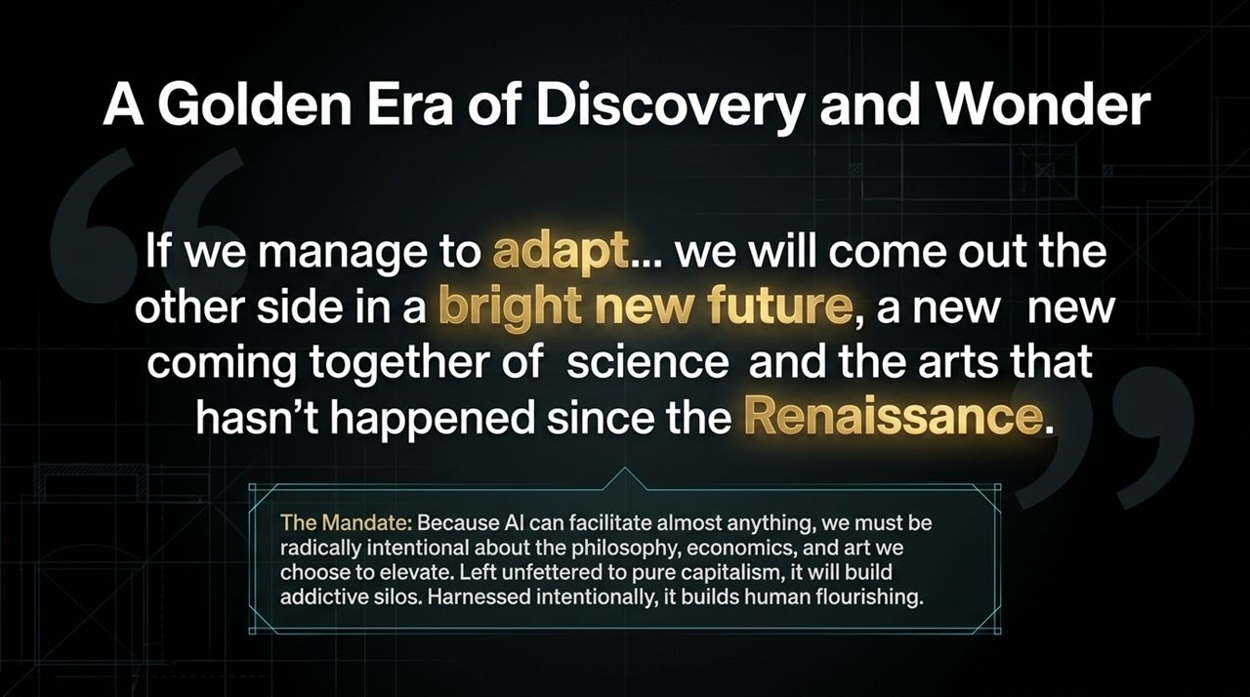
Notes:
If we manage this transition with care and intentionality, what does the destination look like?
Demis summarizes it beautifully in this quote: "If we manage to adapt... we will come out the other side in a bright new future, a new new coming together of science and the arts that hasn't happened since the Renaissance."
We stand at the threshold of a new Golden Era. For the past 200 years, science and the arts have operated in separate silos, speaking different languages. AI is the bridge that brings them back together.
However, this transition comes with an urgent mandate: Because AI can facilitate virtually anything, we must be radically intentional about what we choose to elevate.
If we leave AI entirely to unfettered market forces and click-bait algorithms, it will build addictive digital silos, flood the web with low-quality content, and amplify social division. But if we harness it intentionally—guided by humanistic philosophy, art, and ethics—it will unlock an unprecedented flourish of human creativity, curiosity, and scientific discovery.
The technology itself is neutral; it reflects our collective values and priorities.

Slide 14
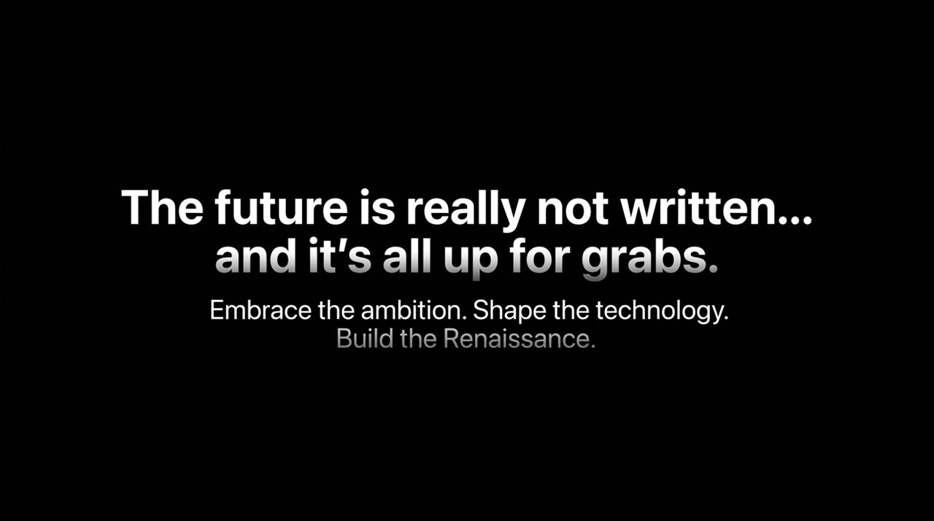
Notes:
As we conclude this exploration of Demis Hassabis's vision, let us reflect on the core call to action:
"The future is really not written... and it's all up for grabs."
There is a dangerous tendency today to treat technological determinism as inevitable—to assume that AI will automatically lead to either a dystopian nightmare or a corporate oligopoly. But history shows that technology takes the shape of the hands that guide it.
The future is unwritten. Every decision we make today—as scientists, educators, business leaders, artists, and policy-makers—determines the world we will inhabit tomorrow.
The mandate is clear:
Embrace the ambition: Do not settle for small, incremental optimizations. Aim AI at humanity's hardest problems.
Shape the technology: Embed ethics, safety, and human dignity into every algorithm and system.
Build the Renaissance: Merge the technical rigor of science with the soul and meaning of the arts.
Thank you very much. I look forward to taking your questions.

Slide 15
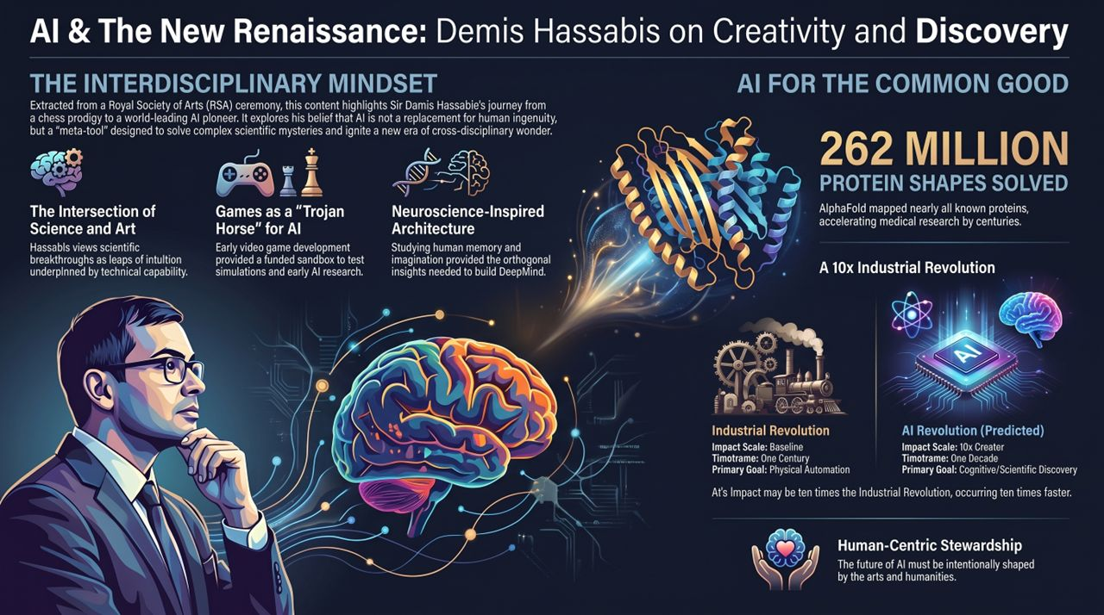
Notes:
To wrap up our session, Slide 15 provides a high-level executive summary of Sir Demis Hassabis’s address at the Royal Society of Arts. This slide serves as a consolidated reference for the three core themes we have explored today:
1. The Interdisciplinary Mindset: Demis’s journey—from world-class chess prodigy to game developer, neuroscientist, and founder of DeepMind—demonstrates that breakthroughs happen at intersections. Games provided the simulated training grounds; neuroscience provided the biological architecture; and AI brought them together. True innovation requires pairing leaps of creative artistic intuition with rigorous technical capability.
2. AI for the Common Good: The practical proof of this philosophy is AlphaFold. By solving 262 million protein structures, DeepMind didn't lock the data behind a paywall—they gave it away freely to the global scientific community, accelerating biological and medical research by decades.
3. A 10x Industrial Revolution: We must prepare for a shift that is 10 times greater in impact and occurring 10 times faster than the Industrial Revolution. While the Industrial Revolution automated physical labor over a century, the AI Revolution is augmenting cognitive discovery over a single decade.
Conclusion: Ultimately, AI is a human-centric story. It demands stewardship grounded in the arts, humanities, and ethics. If we guide this technology with intentionality, we will not be replaced—we will be elevated into a vibrant new Renaissance of human knowledge and creativity.

